Slide 1
Faculty Retreat on General Education: the Next Steps
GE Taskforce Presentation
April 20, 2012

Slide 2
Our goals for today:
Explain GE taskforce approach to revision process since Nov 2011 retreat
Share feedback UCCS faculty and students
Present new GE Framework
Subteams present ideas about specific GE components
Allow faculty time to discuss ideas presented and to give feedback and input
Present plans for the summer and fall 2012

Slide 3
GE Revision Process
Phase I: Revision of UCCS
General Education goals
Nov 2010: UCCS campus-wide faculty vote approving revised GE Goals (93% approval)

Slide 4
UCCS General Education Goals
Vision: General education at UCCS prepares students for success in their majors, professional pursuits, and lives as creative, thoughtful, informed, and engaged members of our diverse, global society.
The goals of our general education program focus on three interrelated areas of learning, all of which are essential to an undergraduate education. Through the general education curriculum, students will develop competencies in each area and the ability to integrate these competencies as a foundation for lifelong learning.
  Evaluate and Create
  Know and Explore
  Act and Interact

Slide 5
1) Evaluate and Create
  Students will develop intellectual and practical skills central to investigation, creative pursuits, and problem solving. Students will gather, understand, analyze, and evaluate information as well as synthesize that information in order to create and articulate new ideas. This includes:
    Critical and creative thinking
    Quantitative and qualitative reasoning
    Information literacy
    Communication: reading, writing, speaking, and listening

Slide 6
2) Know and Explore
  Students will have a broad understanding of fundamental explorations, applications, and innovations in the natural sciences, social and behavioral sciences, and arts and humanities. Includes knowledge of:
    The physical and natural world
    Humanities, arts, and culture
    Society, social and economic institutions, health, and human behavior

Slide 7
3) Act and Interact
  Students will cultivate self-awareness and understanding of their impact—locally, nationally, and globally. Students will be prepared to participate effectively in a society that encompasses diverse experiences, perspectives, and realities. This area includes:
    Responsibility – personal, civic and social
    Engagement – creative, collaborative, artistic and innovative
    Inclusiveness – competencies for cultural responsiveness across social differences in contexts ranging from local to global
    Sustainability – understanding the interaction between human development and the natural environment

Slide 8
Current college general education requirements
Elementary
Education
Nursing
Criminal Justice
LAS
total = 53-54
total = 49
total = 48
Business
total = 45-49
Engineering
total = 37
total = 31
= GE credit hours decided by each college

Slide 9
Current college general education requirements
Elementary
Education
Nursing
Criminal Justice
LAS
total = 53-54
total = 49
total = 48
Business
total = 45-49
Engineering
total = 37
total = 31
27
9
15
23-27
31-32
26
+
+
+
+
+
+
22
22
22
22
22
22
= existing common GE requirements across colleges
= remaining GE credit hours
to be decided by each college

Slide 10
Our existing general education
Existing common GE requirements across the
colleges (22 credit hours)
English
1310
3 cr.
3 cr. Hum or Soc. Sci.
3 cr. Hum or Soc. Sci.
Quantitative
Reasoning
3 cr.
2nd
Writing
Course
3 cr.
portfolio
3 cr. Hum or Soc. Sci.
4 cr. Natural Sci.

Slide 11
GE Revision Process
Phase II: Feb 2011 to present
Task: to design a structure to
  Implement the new GE goals through a university-wide general education curriculum
  Allow faculty governance of that new curriculum

Slide 12
Our Approach to GE Revision
Faculty-driven and faculty-centered
Required clear understanding of our current college-based GE curricula
Aim to build on/ learn from the strengths of our current GE curricula
Crucial to engage with and learn from key constituent groups
Desire to create a flexible, visionary, implementable GE structure rooted in faculty governance and engagement

Slide 13
GE Taskforce used insights from
students faculty advisors employers research
to guide our work developing:
new intentional, coherent GE framework
rooted in high impact practices
fulfilling UCCS’s 2010 GE Goals

Slide 14
Student Focus Groups—Spring 2012
Three student focus groups of 10-12 students each in March 2012
Two groups of UCCS juniors and seniors who completed nearly all of their GE requirements at UCCS
One group of students who transferred to UCCS with some of their GE requirements completed elsewhere

Slide 15
What UCCS students identified as the most important reasons for attending college:
To gain specific skills and knowledge in my field
To have greater job opportunities
To develop critical thinking and problem-solving
To acquire knowledge, capabilities, ethics and values for professional success

Slide 16
What our students say about our current GE programs at UCCS
They value
  Breadth, exploring new ideas
  Developing basic skills-writing, research, speaking, etc.
  Having choices
  Courses with smaller class sizes
They don’t like
  Lack of clarity about the purposes of GE
  Confusing GE requirements that fail to make sense
  Lack of flexibility
  Inconsistent workloads in GE courses
  How it is set up for them to just go through motions; to take the path of least resistance

Slide 17
What are UCCS faculty concerns about our current GE?
  Lack of intentionality
  Inconsistent level of rigor across courses
  Lack of connection with GE goals
  Some students and faculty don’t understand GE curricula
  How students continue to struggle with foundational skills, like writing and math, at a university-level

Slide 18
What did UCCS advisors say about the student experience of GE
Students don’t understand the purpose of GE requirements
GE requirements don’t make sense to students
They take courses to fit their schedule; take the path of least resistance
Students complain about the inconsistency between courses, between different college GE requirements
Students want to be able to “explore” different professions within their GE requirements.

Slide 19
What employers say when asked… Which is more important for recent college graduates who want to pursue long-term success at your company?
Broad range of skills and knowledge that apply to a range of fields or positions
20%
In-depth knowledge and skills that apply to a specific field or position
20%
BOTH in-depth AND broad range of skills and knowledge
59%

Slide 20
What employers say
How important is a college education that “helps
students develop a sense of social responsibility,
as well as intellectual and practical skills,…and a
demonstrated ability to apply knowledge and skills?”
Not Sure
Not
Important
Very
Important
Fairly
Important

Slide 21
What does the research show?
AAC&U’s (American Association of Colleges and Universities) LEAP (Liberal Education, America’s Promise) Initiative
High-Impact Educational Practices
Research report: (http://www.aacu.org/leap/hip.cfm)

Slide 22
High-Impact Practices
First-Year Seminars and Experiences
Capstone Courses and Projects
Common Intellectual Experiences - Core Courses
Writing Intensive Courses
Undergraduate Research
Collaborative Assignments and Projects
Service Learning
Learning Communities

Slide 23
Research Findings
3+ HIP
3+ HIP
2 HIP
2 HIP
1 HIP
1 HIP
none
none

Slide 24
Research Findings

Slide 25
Challenges to address in our new GE curriculum
Communicate our GE vision to faculty and students
Ensure that fundamental skills transfer to a student’s major
Integrate consistently high impact practices
Create coherence, intentionality, and integration

Slide 26
November 2011 Retreat discussion
Need Pathway to provide integration and coherence
High-impact practices
  First-year seminars
  Capstones
  Common intellectual experiences
“Components”
  Gateway
  Capstone
  Core integrative courses
  Themed list
  Existing common courses

Slide 27
What we heard from faculty at the retreat
Emphasize high impact practices, connection to UCCS general education goals
A gateway course, based on a modified freshman seminar model, is desirable, provide coherence
A capstone tied to the major is something to pursue
A common experience core course at the junior level makes sense
Writing beyond the two required core courses, embedded in disciplinary majors, is important
Faculty wanted more opportunities to dialogue about what they are already doing and how to change/improve on it.
Little enthusiasm for themes

Slide 28
What do faculty want from a new GE curriculum—based on Spring 2012 Faculty Dialogues?
  Fulfill the new GE goals
  Help students become well-rounded citizens
  Writing and other skills developed for the major and future profession
  Students should understand the curriculum’s intent and how it will help them
  Feed into the major

Slide 29
What concerns faculty about changing GE curriculum?
  May add too many credits; won’t fit into accreditation standards for professional programs
  Will prevent students from taking courses in majors other than their originally-intended one
  May not be enough change - new curriculum will have same problems as the old
  Implementation may keep good ideas from working
  Won’t include advising as a crucial element

Slide 30
A New Framework for General Education at UCCS
General Education is foundational skills and knowledge embedded throughout the four years of study in the bachelor’s degree.
This framework emerged based on a convergence of input that we received from key groups.
Foundational Education should provide students with breadth, depth, well-developed skills applied in multiple contexts.

Slide 31
A New Framework for General Education at UCCS
Depth = “Core”: Existing writing courses, quantitative reasoning, Gateway course, 3000-level core integrative course, capstone
Breadth = “Explore”: A range of disciplinary courses used to meet the “Know & Explore” GE Goal

Slide 32
GE Taskforce worked in subteams
Six Subteams—included more faculty beyond GE Taskforce
Faculty Dialogue
Gateway
Core (3000-level integrative class)
Explore
Writing Across the Curriculum
Capstone

Slide 33
New Framework for GE
Re-frames 22 cr. existing common GE across colleges
High impact practice framework
Includes 24 cr. of GE across colleges
Plus, an additional 0-3cr. Capstone Experience GE embedded within the major departments
Including 1 to 3 courses designated as Writing Intensive (possibly fulfilled in a range of areas in the GE, general electives, or major degree courses)

Slide 34
A New Framework for GE at UCCS
4th Year
Capstone
Core
Integrative Course
Writing Portfolio
3rd Year
Writing
Intensive Designated
2nd Year
Explore
Explore
Explore
1st Year
Gateway:
Freshman
Seminar
2nd
Writing
Course
Quantitative
Reasoning
English
1310

Slide 35
24+ cr. hr. GE Framework
Elementary
Education
Nursing
Criminal Justice
total = 53-54
LAS
total = 48
total = 49
Business
total = 45-49
Engineering
total = 37
total = 31
25
7
13
21-25
29-30
24
+
+
+
+
+
+
24
24
24
24
24
24
= existing common GE requirements across colleges
= remaining GE credit hours
to be decided by each college

Slide 36
24+ cr. hr. GE Framework within LAS Bachelor’s Degree
0-3 cr. hrs. in major
71-75 cr.
Capstone
Major coursework and general electives
120 cr. hrs.
WIC
1–3 courses designated writing intensive
21-25 cr.
+
+
24 cr.
Total GE cr. = 45-49
= university-wide GE requirements
= remaining GE credit hours
to be decided by each college

Slide 37
The 24+ cr. hr. GE curriculum embedded within
120 cr. hr. Bachelor’s Degree
4th Year
WIC
Capstone
3rd Year
Core
2nd Year
Explore
Course
Explore
Course
Explore
Course
1st Year
Freshman
Seminar
English
1310
2nd
Writing
Quantitative
Reasoning

Slide 38
The 24+ cr. hr. GE curriculum embedded within
120 cr. hr. Bachelor’s Degree
4th Year
Capstone
3rd Year
WIC
Core
2nd Year
Explore
Course
Explore
Course
Explore
Course
1st Year
Freshman
Seminar
English
1310
2nd
Writing
Quantitative
Reasoning

Slide 39
The 24+ cr. hr. GE curriculum embedded within
120 cr. hr. Bachelor’s Degree
4th Year
Capstone
3rd Year
Core
2nd Year
Explore
Course
Explore
Course
Explore
Course
1st Year
Freshman
Seminar
English
1310
2nd
Writing
Quantitative
Reasoning

Slide 40
Existing common requirements
English 1310 – Academic Reading and Analytical Writing
2nd Writing Course – satisfied by ENGL 1410 (LAS, CJ, Beth-El), ENGL 2060 (EAS), ENGL 2080 (COB), or INOV 2100 (BI)
Quantitative Reasoning – each college or department has a specific course or choice of courses to satisfy
English
1310
2nd
Writing
Course
Quantitative
Reasoning

Slide 41

A New Framework for GE at UCCS
4th Year
Capstone
Core
Integrative Course
Writing Portfolio
3rd Year
Writing
Intensive Designated
2nd Year
Explore
Explore
Explore
1st Year
Gateway:
Freshman
Seminar
2nd
Writing
Course
Quantitative
Reasoning
English
1310

Slide 42
Why Have a Gateway Course?
Gateway:
Freshman
Seminar
Freshmen arrive:
  With different expectations about college
  With different levels of preparation
  At different stages of developmental maturity
Can we get them all on the same page?
Perhaps not, but we can do some useful things!

Slide 43
What a Gateway Course Can Do
Gateway:
Freshman
Seminar
Welcome them to the university
Introduce them to an academic culture through the Core & Explore Goals
Review and expand upon the academic skills needed for success
Get them started on achieving the Core & Explore goals
Generate enthusiasm for the rest of their Core & Explore curriculum

Slide 44
Why Leverage Freshman Seminar?
Gateway:
Freshman
Seminar
It has become a national model in the integrative learning movement
It strives for most of the same outcomes as a Gateway Course
It is voluntary but is already taken by over 80% of fall freshmen
It has over 20 years of experience with what works and what doesn’t

Slide 45
What We’ve Learned From FS
Gateway:
Freshman
Seminar
Successful FS courses are also rigorous college courses
Faculty development is crucial so that faculty learn the high impact practices that work
Staying open to new content suggestions has resulted in the opportunity for creativity and innovation
Supporting faculty teams with JTAs has enriched the program

Slide 46
Implications for making FS the Gateway course
Gateway:
Freshman
Seminar
Gateway course would be required
FS is taught off-load; may not be a sustainable model for a required course
Gateway course must cover 100% of a growing freshman class
Gateway course would need to be offered Fall and Spring
The academic rigor is sometimes uneven, as reported by students

Slide 47
Next Steps for Pursuing the Gateway Course Idea
Gateway:
Freshman
Seminar
Collect your ideas on the Gateway Course Questions sheet – today!
Engage in a dialogue with Freshman Seminar faculty at retreat in May
Continue work on a governance model to support quality control across the Core & Explore curriculum

Slide 48
Gateway Activity
Gateway:
Freshman
Seminar
Please fill out the Gateway course questions sheet (double-sided)
When you are finished, please take a brief 10-15-minute break.
Please return promptly.

Slide 49
Faculty Retreat on General Education
Break

Slide 50
A New Framework for GE at UCCS
4th Year
Capstone
Core
Integrative Course
Writing Portfolio
3rd Year
Writing
Intensive Designated
2nd Year
Explore
Explore
Explore
1st Year
Gateway:
Freshman
Seminar
2nd
Writing
Course
Quantitative
Reasoning
English
1310

Slide 51
Aims of the Explore Curriculum
Explore
to expose students to a breadth of disciplinary approaches, perspectives, and methods.
to provide a broad level of understanding within a particular discipline.

Slide 52
Why Re-frame the
Explore Curriculum?
Explore
Re-frames the LAS “Area Requirements”
Creates a student-centered, learning-focused curriculum
Allows students to take courses across UCCS colleges and in foreign languages as part of their GE
Highlights how knowledge is produced, analyzed, and discussed in disciplines—ranging from the arts to natural sciences
Develops rigor, intentionality, coherence, but maintains a flexibility for faculty and students in course offerings

Slide 53
Basic Idea behind Re-framed Explore Curriculum
Explore
Students would take 3 courses (3 credits each = total 9 credits)—one course in three different categories—pushing them to explore disciplinary perspectives in order to gain a breadth of knowledge.
The four broad categories we developed are rooted in the traditional divisions (arts, humanities, social sciences, and natural sciences), but expand them to include courses offered by the professional colleges as well.

Slide 54
Option 1: “Discovery” Concepts
Explore
Expression → Arts, Creative Writing, and
Foreign Languages
Enlightenment → Humanities and Cultures
Engagement → Social Sciences, Business, Health Sciences, Criminal Justice
Exploration → Natural Sciences, Engineering,
Computer Science, and Nursing

Slide 55
Option 2: “Adventurer” Concepts
Explore
Creator → Arts, Creativity, and Innovation
Traveler → Humanities, Cultures, and
Foreign Languages
Pathfinder → Social Sciences, Business, Health
Sciences, Criminal Justice
Pioneer → Natural Sciences, Engineering,
Computer Science, and Nursing

Slide 56
Guidelines for
Explore Curriculum
Explore
All courses would also be asked to adhere to some general guidelines to ensure breadth of experiences, approaches, and methods.
Guidelines frame how knowledge is defined, acquired, evaluated, and applied within the field.
Teaching faculty could develop guidelines for each subcategory--Expression, Enlightenment, Engagement, Exploration, etc.

Slide 57
For example, Explore courses could be asked to address…
Explore
Knowledge of the essential terminology, concepts, and topics of the discipline.
Skills, concepts, analytical tools, and/or basic research methods for engaging within the field.
Opportunities for students to practice foundational skills, such as writing, oral communication, or qualitative and/or quantitative reasoning, among other possibilities, within an applied context.
Discussion, methods, and direction for assessing data and claims to new knowledge.
Presenting ways to evaluate claims to knowledge outside the discipline (interdisciplinary perspectives) using the knowledge gained within the course.

Slide 58
Explore table discussion and feedback form
Explore
Table Discussion: Which “option” do you prefer:
Option 1 “Discovery”
or Option 2 “Adventurer” ?
Table Discussion: In your opinion, how difficult would it to address these sample guidelines in some of your existing courses?
On the back side of your Explore Curriculum handout, please complete the specific feedback questions.

Slide 59
A New Framework for GE at UCCS
4th Year
Capstone
Writing
Intensive Designated
Core
Integrative Course
Writing Portfolio
3rd Year
2nd Year
Explore
Explore
Explore
1st Year
Gateway:
Freshman
Seminar
2nd
Writing
Course
Quantitative
Reasoning
English
1310
Quantitative
Reasoning

Slide 60
Why an upper-division core integrative course?
Core
Integrative Course
Reinforce goals of UCCS education
Require course for transfer students
Underscore creative thinking, educational breadth
Integrate, draw connections with major field of study
Students build on GE education throughout UCCS degree
Gateway ➔ Explore➔ Advanced Core ➔Capstone

Slide 61
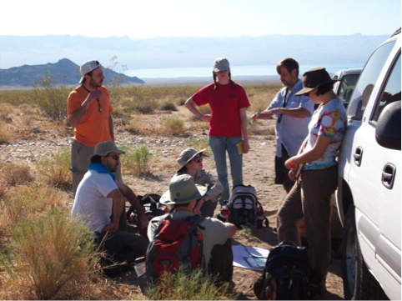
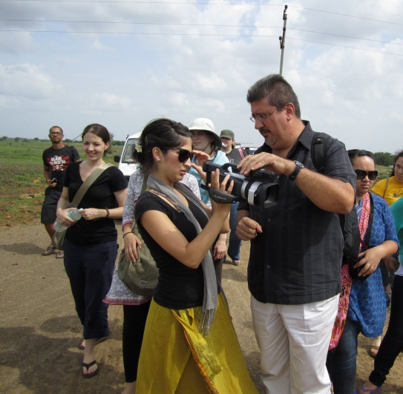
Unifying Concept: “Knowledge in Action”
Core
Integrative Course
Learning by doing
Applied knowledge - problem solving, building, creating, etc.
In depth work with faculty from other disciplines and/or colleges
High Impact practices
Work with other students from diverse backgrounds
Build on UCCS existing courses
Writing – critical thinking, connecting research to ideas, applications

Slide 62
Format of Courses
Core
Integrative Course
Require courses with common “knowledge in action” templates
Offered by multiple departments across all colleges
Encourage engaging, groundbreaking, multidisciplinary classes using best practices
Encourage new paradigms – connections across fields, departments and colleges
  team teaching across colleges and other innovations
Field Based
Cross Disciplinary
Service Learning
Performance Based
Travel Course
Action Research
Team Taught

Slide 63
Core and Explore Discussion
Table Discussion
Take the next 30 minutes
  Start with either the ‘Knowledge in Action’ course or the Explore Curriculum
  Use handouts as discussion guides.
  If you finish before the half hour is up, please take up the other discussion for the remaining time
Core
Integrative Course
Explore

Slide 64
A New Framework for GE at UCCS
4th Year
Capstone
Core
Integrative Course
Writing Portfolio
3rd Year
Writing
Intensive Designated
2nd Year
Explore
Explore
Explore
1st Year
Gateway:
Freshman
Seminar
2nd
Writing
Course
Quantitative
Reasoning
English
1310

Slide 65
Feedback about Writing from Fall GE Retreat
Writing should be integrated across students’ academic careers
Writing instruction should happen in both GE and students’ majors
Students who graduate from UCCS should receive writing instruction at UCCS (vs. only transfer credit for writing courses)
Writing is valued and relevant as a teaching tool and student skill outcome

Slide 66
Writing Intensive Courses
Writing
Intensive
Writing instruction embedded in courses
Focus on the writing process and revision
Often focus on disciplinary-specific genres and conventions
Often include a minimum number of written pages
Courses are small (19-30 students)
Faculty are supported (faculty development, off-loads, stipends, evaluations, in-class tutors)

Slide 67
Benefits of Writing Intensive Courses
Meet a need articulated by faculty
Increase engagement with course materials
Enable students to develop writing ability over time and multiple writing opportunities
Provide students with meaningful writing experiences
Address disciplinary-specific competencies
Develop a skill that is critical in personal, academic, and professional success

Slide 68
Writing across the Curriculum
Existing Elements
Elements in Progress
Portfolio for Writing Assessment
Assesses students’ writing in their upper division courses and collects data on student performance.
Faculty Seminars
Support faculty incorporating writing instruction into their classes.
Potential Elements
Writing Center
Offers students individualized feedback on their writing at all stages of the writing process.
Faculty Learning Communities
Faculty across the disciplines engage in research and attend retreats, workshops, and other events to facilitate collaboration.
Writing Intensive Courses
Undergraduate Journals
Provide venues for students’ academic and/or creative work.
Writing instruction embedded in courses
Focus on writing process and revision
Courses may be within disciplines or GE
Courses are small
Faculty are supported
Writing Fellows
Writing tutors who receive special training are embedded in writing intensive courses to assist the faculty and students.
Information Literacy
Faculty partner with librarians to teach discipline-specific research strategies.
Writing Plans
Faculty members define and characterize writing in their disciplines and design curricula to help students develop core knowledge and skills.

Slide 69
Writing Intensive Response
Writing
Intensive
At your tables, please discuss the following questions:
  How important is writing to your students in their personal, academic, and professional lives?
  How motivated are you to change an existing course into a writing-intensive course? What resources would you need to do so?
Before you leave today, please fill out the comment sheet about writing intensive courses.

Slide 70
A New Framework for GE at UCCS
4th Year
Capstone
Core
Integrative Course
Writing Portfolio
3rd Year
Writing
Intensive Designated
2nd Year
Explore
Explore
Explore
1st Year
Gateway:
Freshman
Seminar
2nd
Writing
Course
Quantitative
Reasoning
English
1310

Slide 71
Capstone as high-impact practice
Capstone
Increases student engagement
Consolidates and challenges student learning
Connects student learning to career experiences
Provides concluding “cohort experience” for graduating seniors
Demonstrates a student’s ability to write, speak, acquire and use knowledge, solve problems, and apply a variety of skills, including time management and task analysis.

Slide 72
Capstone experiences
Capstone
Senior seminars
Experiential or hands-on courses
Structured Internships
Off-Campus Programs
Structured Independent Study or Research
Service Learning
Honors Projects or Papers
Team/Group Projects
Portfolios/Dossiers
Travel/Immersion Experience

Slide 73
Capstone experiences
Capstone
Meeting between discipline and general education goals
UCCS currently offers many majors that include capstone experiences
  At UCCS, 20 out of the 27 undergraduate degree programs have offered a capstone experience (Switzer, High Impact Practices, 2010).

Slide 74
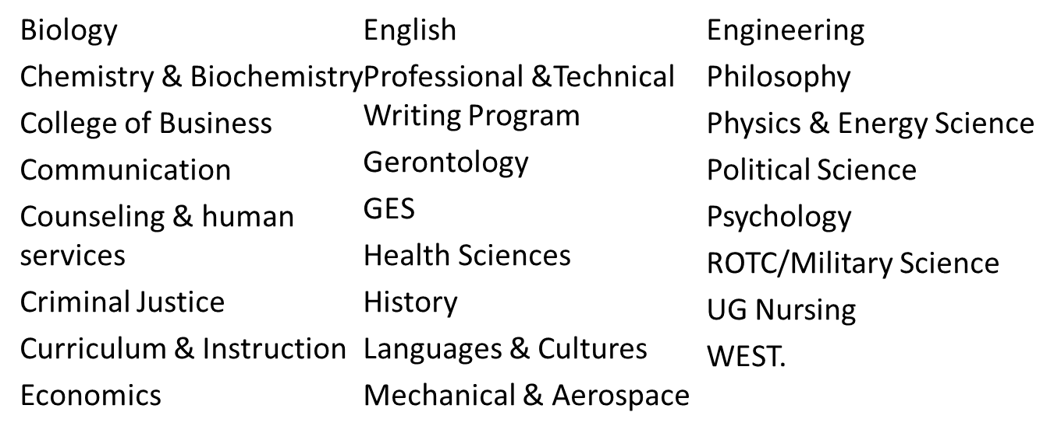
Capstone Survey: March-April 2012
Capstone
Contacted 37 Chairs/UG Program Directors
  29 responded
81% of survey respondents rated capstone experiences for their specific program as valuable

Slide 75
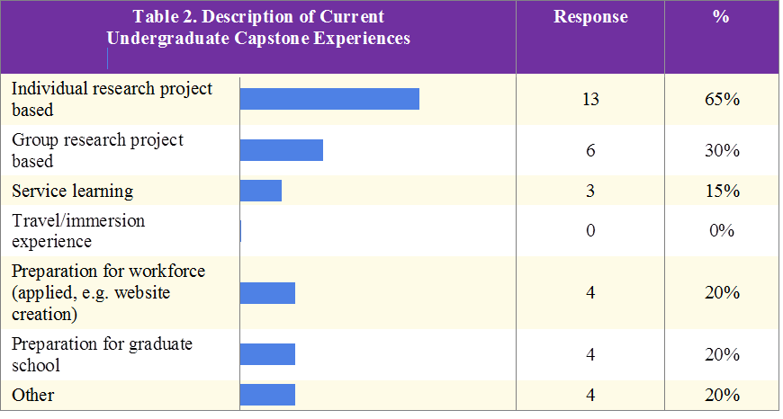
Capstone Survey Results
Capstone

Slide 76
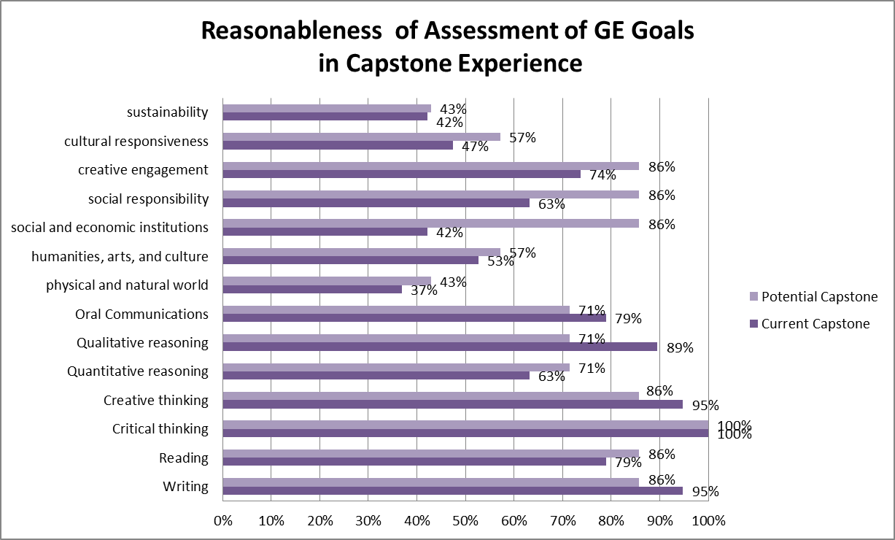
Capstone Survey Results
Capstone
Notes:
N =19

Slide 77
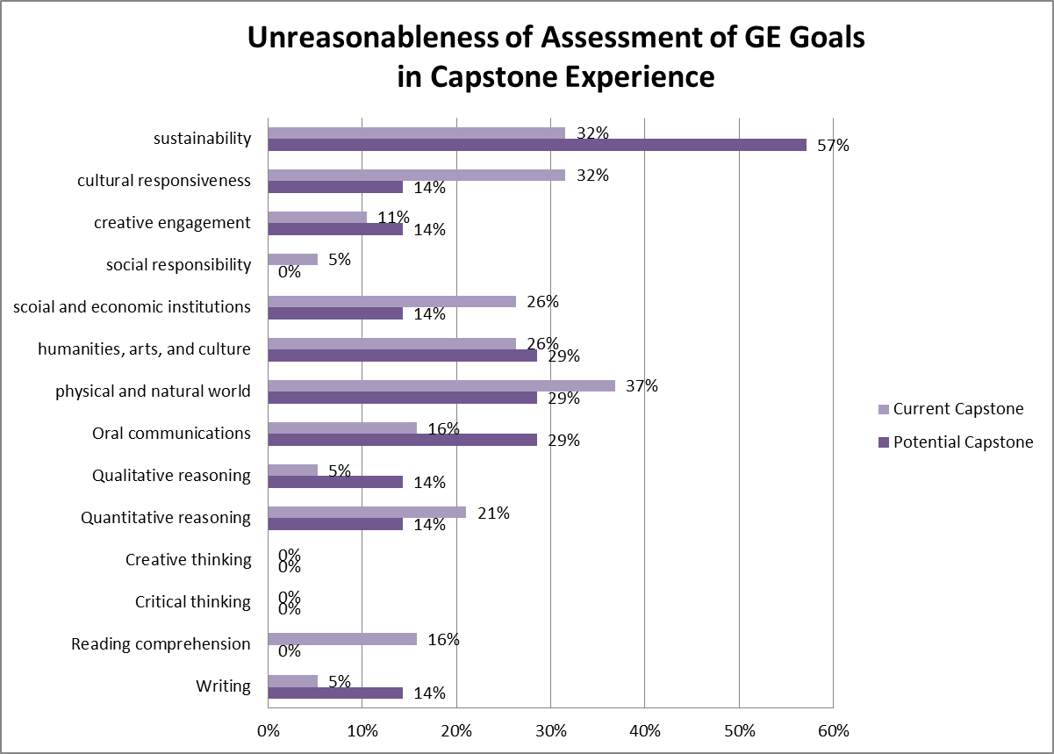
Capstone Survey Results
Capstone
Notes:
N=7

Slide 78
Capstone
Capstone
An Invitation to Continue our Dialogue in Break Out Groups
Call for additional Capstone Information
Summer/Fall 2012 Working with Departments

Slide 79
A New Framework for GE at UCCS
4th Year
Capstone
Core
Integrative Course
Writing Portfolio
3rd Year
Writing
Intensive Designated
2nd Year
Explore
Explore
Explore
1st Year
Gateway:
Freshman
Seminar
2nd
Writing
Course
Quantitative
Reasoning
English
1310

Slide 80
1) Evaluate and Create
Critical thinking
Creative thinking
Quantitative reasoning
Information literacy
Reading
Writing
Speaking

Slide 81
2) Know and Explore
The physical and natural world
Humanities, arts, and culture
Society, social and economic institutions, health, and human behavior

Slide 82
3) Act and Interact
Responsibility
Engagement
Inclusiveness
Sustainability

Slide 83
Moving Forward through 2012
All-faculty survey: May-June 2012
Summer 2012 sub-team work
Fall 2012-Pilot courses of the gateway, integrative core, and writing-intensive courses
Fall discussion about faculty governing structure for GE, budgets, and other processes
Move to next phase: implementation of agreed-upon framework and governing structure by December 2012

Slide 84
Thank you all for attending!
For anyone interested…
Please stay for a “Q & A” with the GE Taskforce after lunch, 1pm start
The full Powerpoint presentation and all handouts will be available on the Provost’s Office website soon.

